Slide 1
Algorithms for Big Data
Raj Bhatnagar
University of Cincinnati

Slide 2
Big Data Situations
Big Data
Data Volume is becoming large:
Tera/Peta Bytes: Relational, Text, Graphs
Data Velocity is becoming large:
100K samples/sec: manufacturing, click streams, medical monitoring
Primary Challenge for Analytics:
Scalability of
Traditional Algorithms
Traditional Computer Systems

Slide 3
Examples of Massive Data
The Large Hadron Collider experiments have 150 million sensors delivering data 40 million times per second.
The Sloan Digital Sky Survey collects astronomical data at a rate of 200 GB per night.
Walmart handles >1 million transactions every hour, by now 2.5 petabytes (2560 terabytes) of data – 167 times the bytes in all the books in the US Library of Congress

Slide 4
Some Business Domains with Big Data
Fraud Detection
Too late after the fraud has been committed
Detect patterns of transactions in large datasets
Evaluate new transactions as per these patterns
IT Log Analytics
Logs of network or system activities are recorded, but not analyzed
Analytics can help discover patterns that lead to problem situations
Call Center Data Analytics
What is going on in a customer’s mind?
Social Media Data Analytics
How the market, advertising campaigns, etc. are responding

Slide 5
Some Scientific Domains with Big Data
Genomics Sequencing Data
Find relationships between genotypes and phenotypes
Protein Interaction Data sets
Patient Electronic Records
Find patient behaviors in response to treatment plans
Find drug interactions and side effects from data
Patient Longitudinal Data
Patient longitudinal histories result in huge datasets
Can help provide prognostics for patients’ treatment options

Slide 6
How Big is Big Data?
1 peta byte = 1000 tera bytes
Data retrieval rate from a storage system (Disk)
100 Megabytes/second
Time to retrieve 1 terabyte ~= 3 hours
Time to retrieve 1 petabyte = 3000 hours
Moving data from one system to the other
Must be avoided
Analyze data where it resides

Slide 7
Major Problems with Big Data
How to store and retrieve it
How to keep it secure and safe
Deriving conclusions from data has pitfalls
Wrong conclusions
“Fast processing” can lead to strong biases
Need moderation by “models” or “humans”
Data analytics cannot be without the context of domain knowledge
Reality check from a human expert
Just because analytics algorithm shows a dependency
Doesn’t make it the truth.

Slide 8
Scaling to Big Data
Individual CPU’s power has reached its limit
The way out is Parallelism
Need enabling hardware configurations
Need matching analytics algorithms
Flexibility in parallel infrastructure
Different data types
Different analytics goals

Slide 9
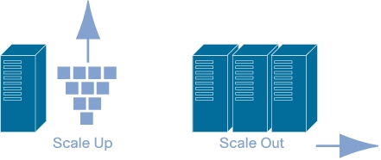
Scaling the Hardware
Horizontal Scalability: Scale Out
Resize by connecting multiple units in cluster
They work together as a single logical unit
Admin can Scale Out by adding more servers, on the fly
Vertical Scalability: Scale Up
Resize by adding more processors/memory to a server
Scaling up has limits imposed by hardware
Needs down time / not on the fly

Slide 10
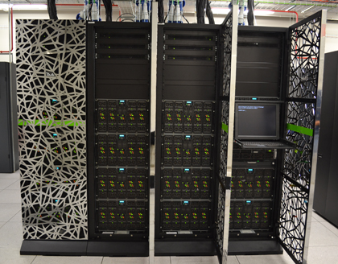
Vertical Scalability
NVIDIA GPU Cluster
Add more CPUs
Add more memory
Mostly proprietary / expensive
Need specialized staff support
Data stays on the same servers

Slide 11
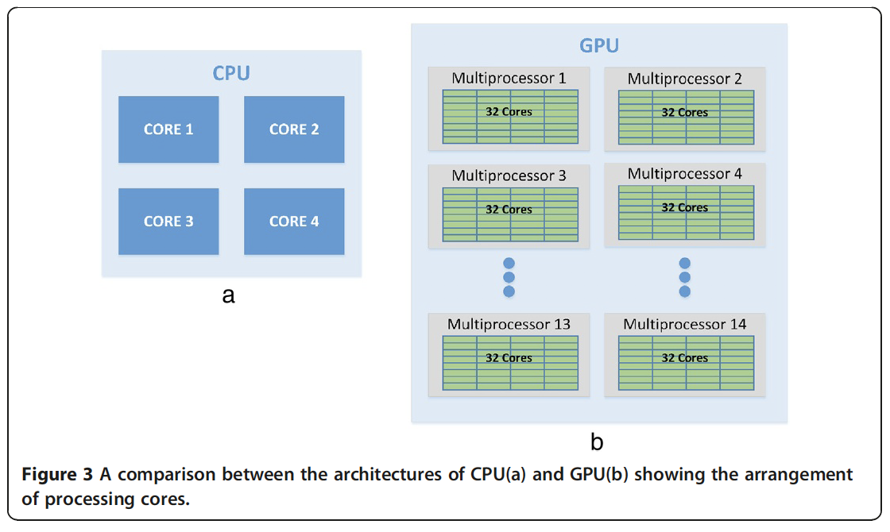
Vertical Scalability

Slide 12
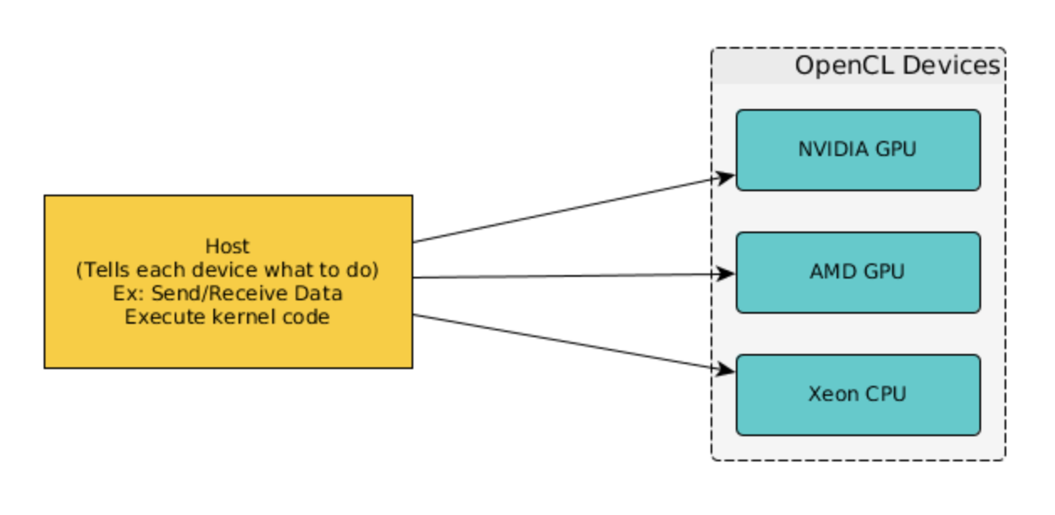
CPU + GPU
Co-Processors
Host CPU
CPU is the ”Controller” and runs the host program
Host program send kernel codes to GPUs, working as co-processors (Assistants)

Slide 13
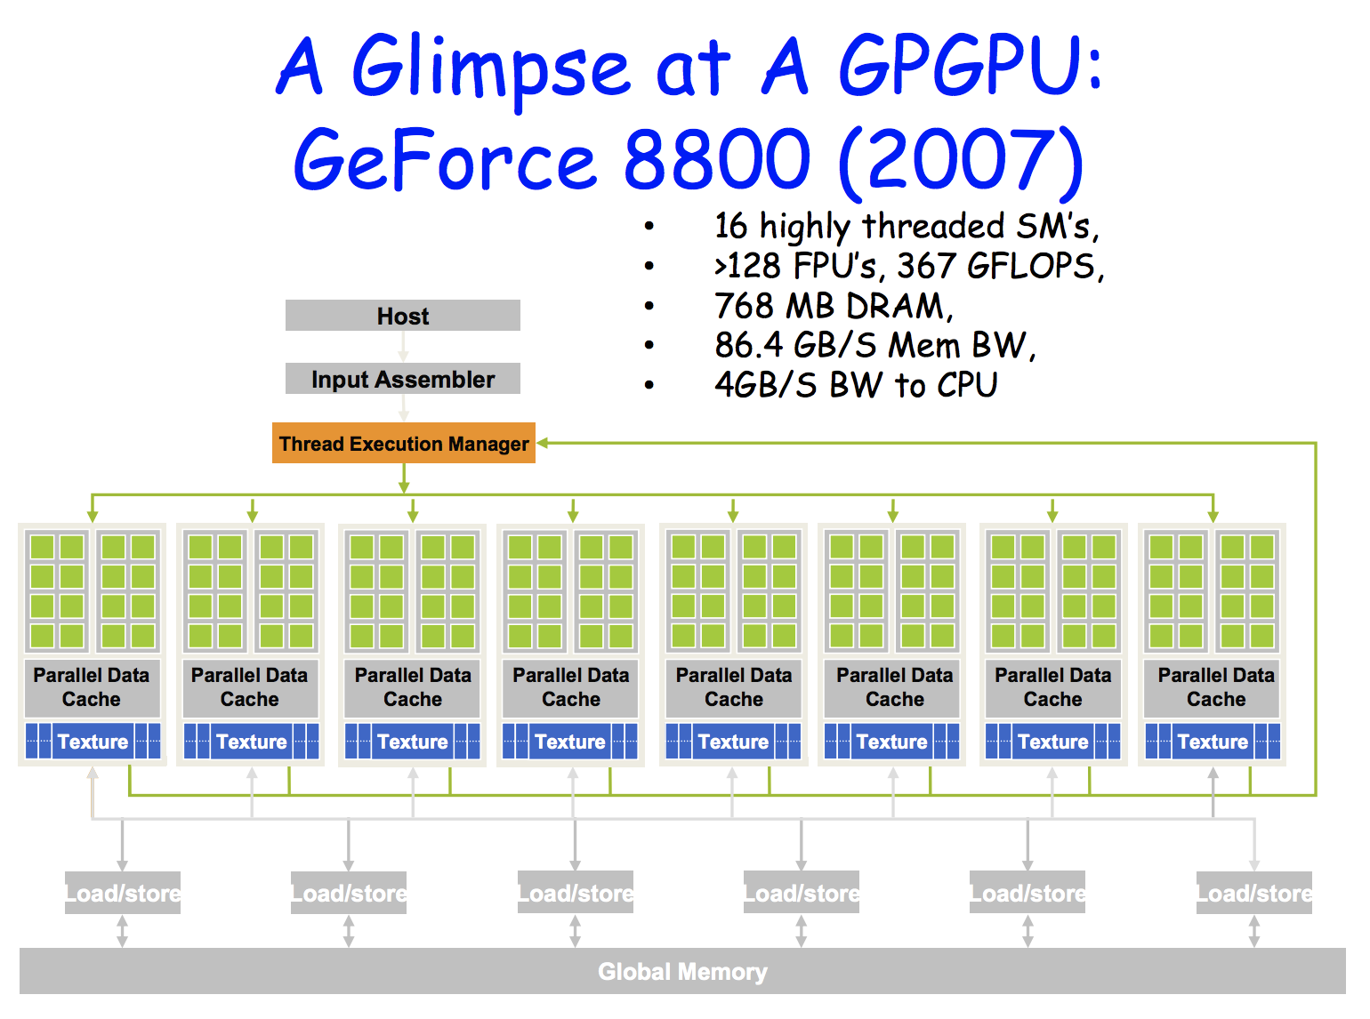

CPU
GPU

Slide 14
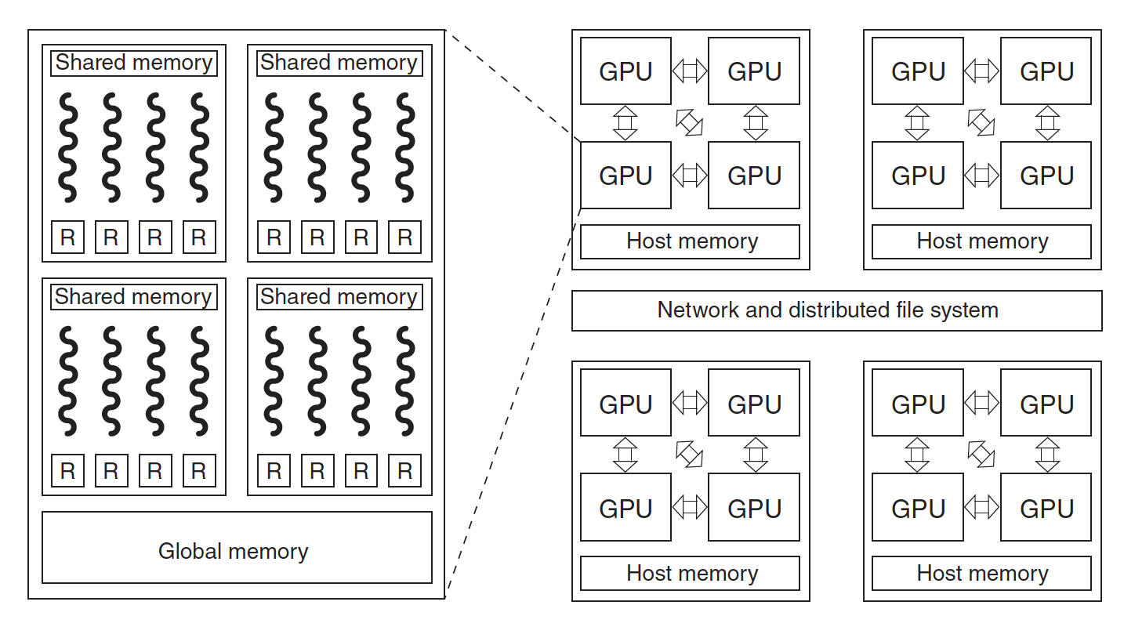


GPU Architecture
Block
Thread/ALU
Global Memory accessible by all threads
High bandwidth, very efficient
Low latency, shared memory, accessible by all threads in a block
Local memory for each thread (R), a set of registers
Each thread has access to 255 32-bit registers in Volta

Slide 15
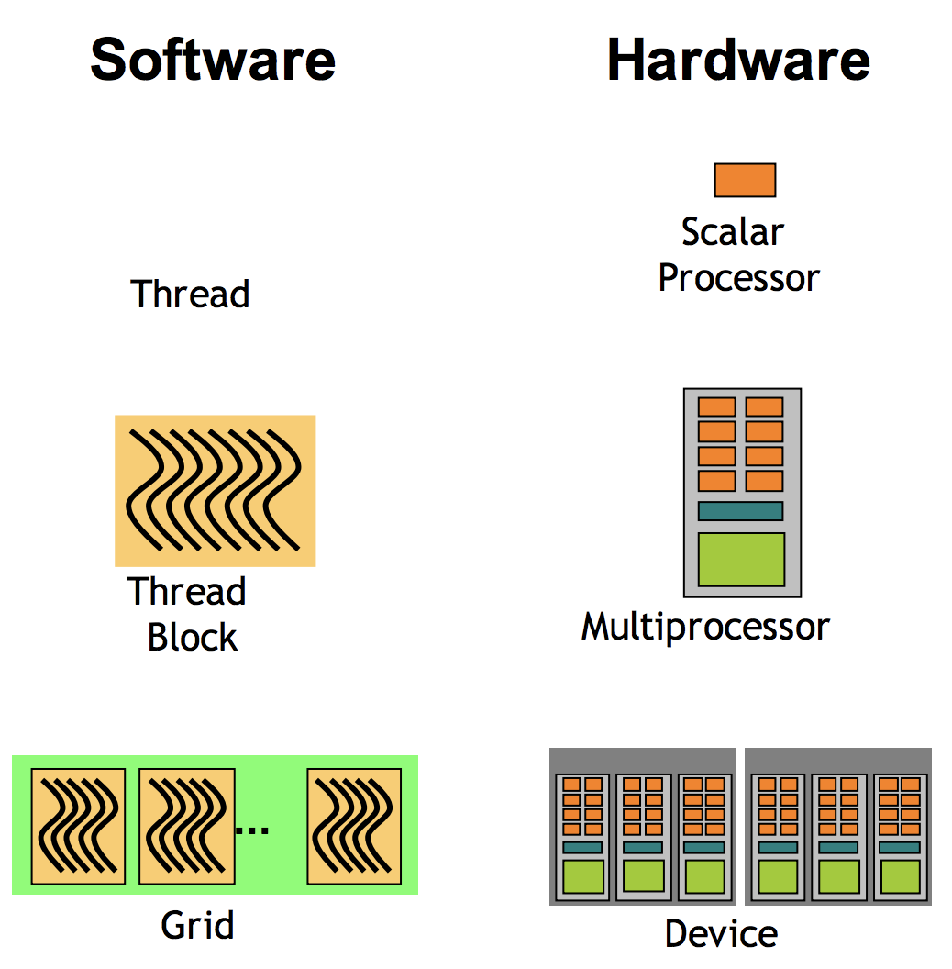

Slide 16
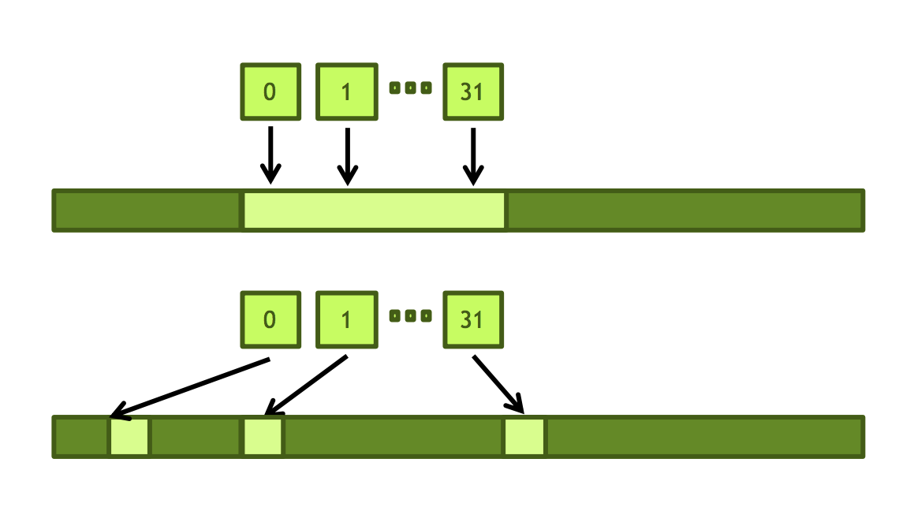


GPU Architecture
Global Memory: memory coalescing
Consecutive threads access consecutive memory locations
Onus is on the algorithm designer!
Irregular access hurts the memory performance

Slide 17
GPU Architecture
Shared Memory:
To help synchronize and combine intermediate data
Combine results of different iterations
Limited to 96KB/multiprocessor in Volta

Slide 18
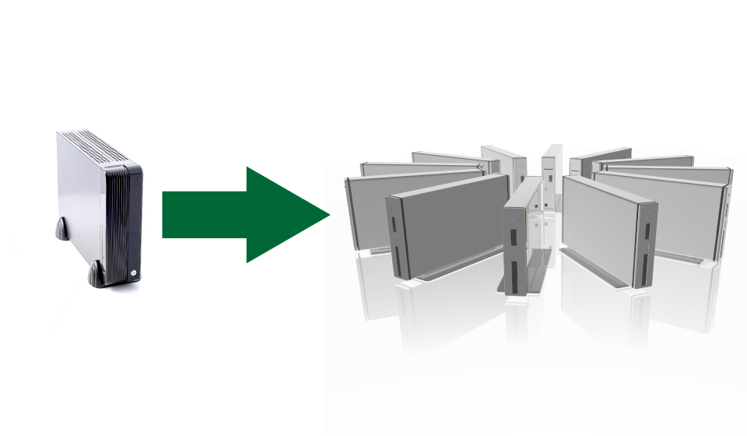
Horizontal Scalability
Nodes/Servers added as needed
e.g. Oracle RAC
Apache/Hadoop Infrastructure
Data is partitioned across servers

Slide 19

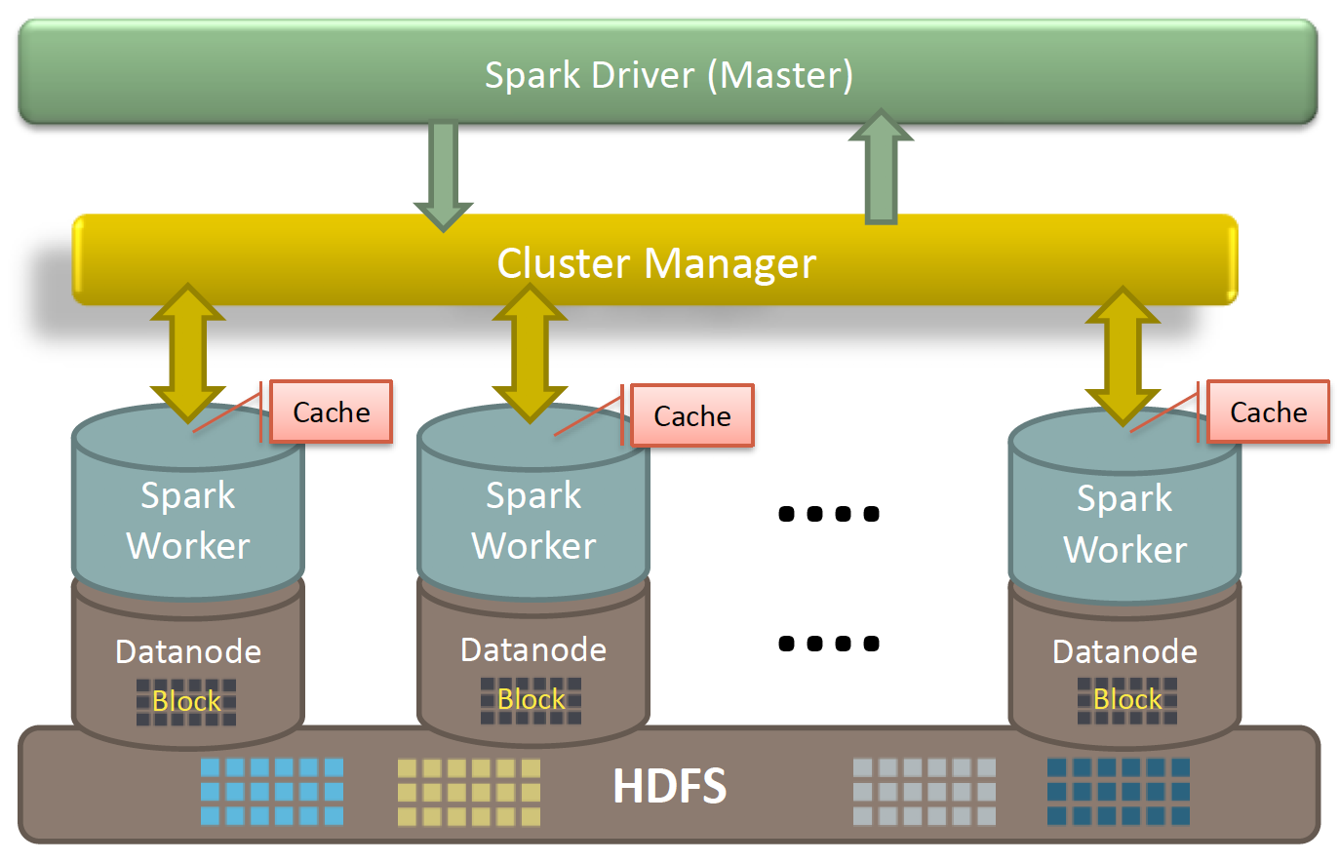
Hadoop and Map-Reduce Paradigm
Data Store
Initial kv pairs
Initial kv pairs
Initial kv pairs
Initial kv pairs
map
map
map
map
k₁, values…
k₁, values…
k₁, values…
k₁, values…
k₃, values…
k₃, values…
k₃, values…
k₃, values…
k₂, values…
k₂, values…
k₂, values…
k₂, values…
Shuffle and sort keys
k₁, values…
k₂, values…
k₃, values…
reduce
reduce
reduce
final k₁ values
final k₂ values
final k₃ values
Data Store
Spark Adds Huge Memory Caches
Leverage large memory
Hadoop’s Map-Reduce Paradigm

Slide 20
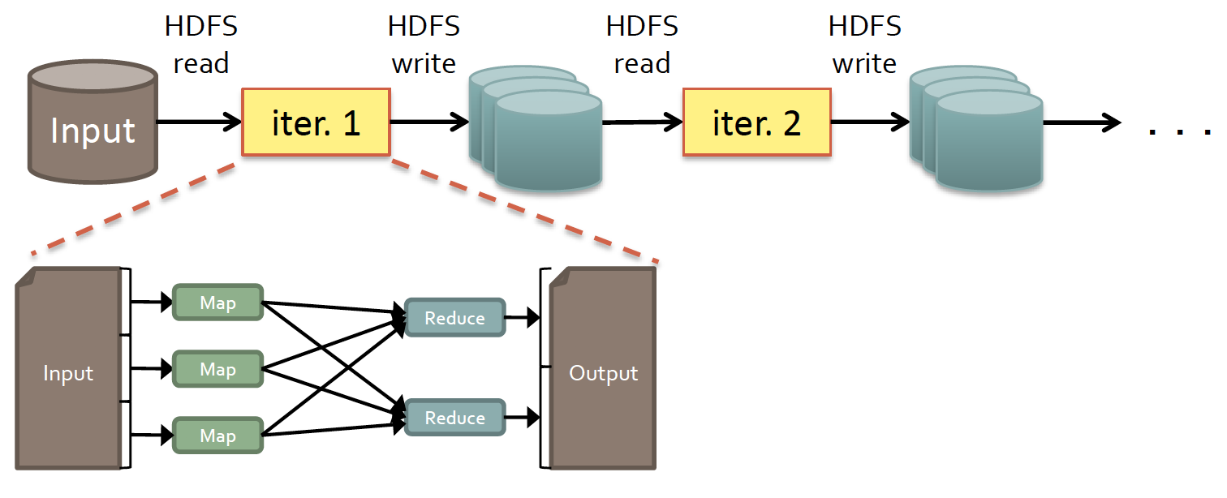
Limitations of Hadoop+MapReduce
SLOW, Due to:
Replication, Serialization, and Disk I/O
INEFFICIENT For:
Iterative Algorithm (Data Mining, Graph Analysis)
Interactive Data Mining (R, Excel, Searching)

Slide 21
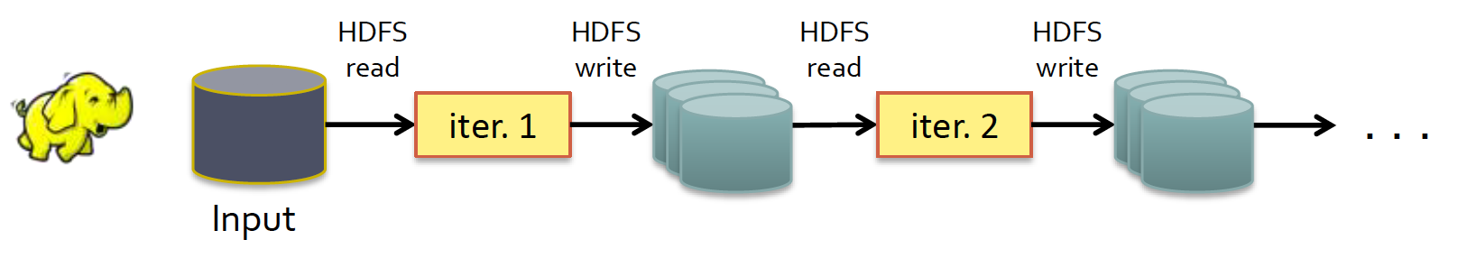
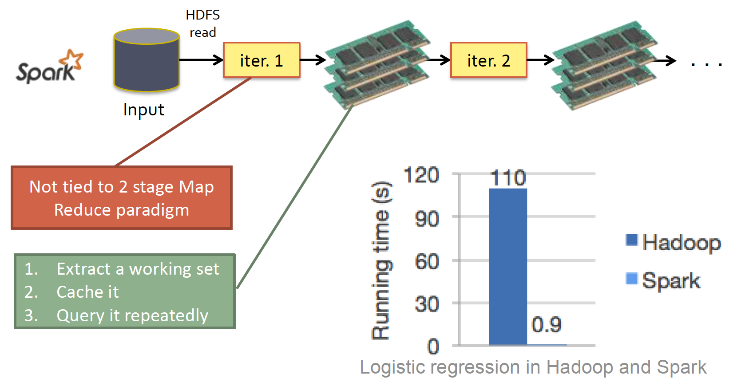
Comparison of Hadoop and Spark
Hadoop
Spark

Slide 22
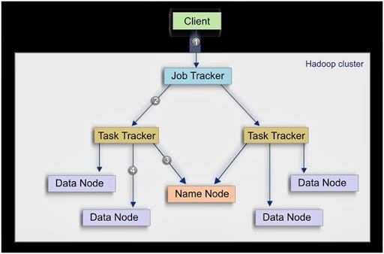
Hadoop Cluster (Horizontal Scaling)
http://samjay-complete.blogspot.com/2014/03/hadoop-basics-horizontal-scaling.html

Slide 23
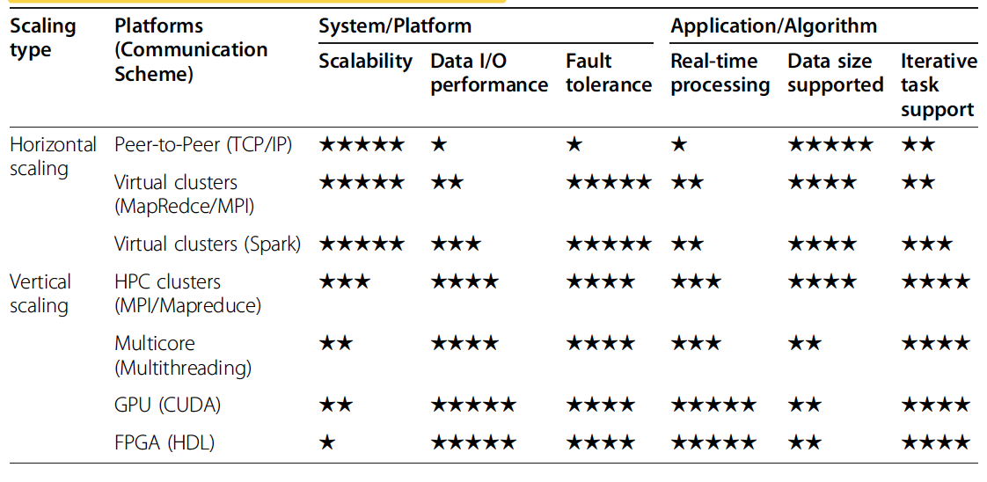
Other Special Platforms for Big Data Analytics
Peer-to-Peer Networks
FPGA
http://samjay-complete.blogspot.com/2014/03/hadoop-basics-horizontal-scaling.html

Slide 24
Algorithms for Horizontal Scaling
Server configuration affords tremendous flexibility
Add/Remove nodes at will
Asynchronous processing
Fault-Tolerance against node failures
Need a versatile algorithmic/programming framework
Can work with arbitrary number of servers
Fault Tolerant
Simply parallel

Slide 25
Functional Programming Constructs: Map Reduce
MapReduce programming
functional programming adapted for distributed processing
Programming construct from the 1950’s
Map and Reduce functions
Commonly used in Scheme, LISP and ML
Computations defined as application of these two functions
Programming paradigm different from that of “data” and “instructions”

Slide 26
LISt Processing (LISP)
Primitive data types are LISTS
Functions are specified in prefix form
'(1 2 3 4 5)
'((a 1) (b 2) (c 3))
(+ 1 2) → 3
(* 3 4) → 12
(sqrt (+ (* 3 3) (* 4 4))) → 5
(define x 3) → x
(* x 5) → 15

Slide 27
Functions in LISP
Functions = lambda expressions bound to variables
Above expression is equivalent to:
Once defined, function can be easily applied:
(define foo (lambda (x y) (sqrt (+ (* x x) (* y y)))))
(define (foo x y) (sqrt (+ (* x x) (* y y))))
(foo 3 4) → 5

Slide 28
Higher Order Functions
Higher-order functions
Functions that take other functions as arguments
(define (apply f x) (f (f x)))
Whatever the function f, just apply it twice.
(define (getSq x) (* x x))
(apply getSq 2) → 16

Slide 29
Map and Reduce Functions
Application of function to List elements = MapReduce?
Lisp is about processing lists
Two important concepts of functional programming
Map: Apply a function to every element of a list
Reduce: Summarize elements of a list into a single value

Slide 30
Higher Order Function: Map
Map is a higher-order function
How does map work:
Arguments to map
A function f
A list of elements
Map applies f to every element in a list
Outputs build a new list
Returned as result (value) of map function
Input List
f
f
f
f
f
f
f
Output List

Slide 31
Higher Order Function: Reduce
Reduce is a higher-order function
What does Reduce do?
Accumulator set to initial value
Reduce is applied to
list element and the accumulator
One element at a time
Result stored in the accumulator
Final result is in the accumulator
Initial
value
f
f
f
f
f
f
f
Accumulate to
Final value

Slide 32
Map-Reduce Example
Simple map example:
Reduce examples:
Sum of squares:
(map (lambda (x) (* x x)) '(1 2 3 4 5)) → '(1 4 9 16 25)
(reduce + 0 '(1 2 3 4 5)) → 15
(reduce * 1 '(1 2 3 4 5)) → 120
(define (sum-of-squares v) (reduce + 0 (map (lambda (x) (* x x)) v)))
(sum-of-squares '(1 2 3 4 5)) → 55

Slide 33
Deploying MapReduce in Hadoop
Consider a very long list of records
Parallelize map operations
Split the list of records
Apply map to each record in each split
Collect map results from all splits
Sort the results
Distribute these results among Reduce tasks
Idea match for Hadoop’s horizontal scaling
No limit to map parallelization
maps are independent

Slide 34
Typical MapReduce Solution
Iterate over a large number of records
Extract something of interest from each
Shuffle and sort intermediate results
Aggregate intermediate results
Generate final output
Map
Hadoop’s
Help
Reduce

Slide 35
MapReduce: Programmer’s View
A list of records at each server
Immutable input data
Available as (k, v) pairs
Programmers specify two functions:
map (k, v) → <k’, v’>
reduce [(k’, v’) . . .] → [<k’’, v’’> . . . .]
All v’ with the same k’ are reduced together
Implementations:
Google’s proprietary implementation in C++
Hadoop is an open source implementation in Java

Slide 36
How an algorithm parallelizes
Data Store
Problem solution needs:
Mapper Function
Reduce Function
Often requires a new algorithm design
Different from that for a serial CPU
Initial kv pairs
Initial kv pairs
Initial kv pairs
Initial kv pairs
map
map
map
map
k₁, values…
k₃, values…
k₁, values…
k₃, values…
k₁, values…
k₃, values…
k₁, values…
k₃, values…
k₂, values…
k₂, values…
k₂, values…
k₂, values…
Shuffle and sort keys
k₁, values…
k₂, values…
k₃, values…
reduce
reduce
reduce
final k₁ values
final k₂ values
final k₃ values
Data Store

Slide 37


Computationally . . .
D1
$$Result=F(D)$$
$$Result=G(g\left(D1\right), g\left(D2\right), g\left(D3\right), . . . . . ., g(DN)$$
D2
D3
$$Result=Reduce(map\left(D1\right), map\left(D2\right), map\left(D3\right), . . . . . ., map(DN)$$
$$D$$
D4
Can the function F be decomposed into equivalent G and g functions?
Some functions F can be decomposed
Into G and g in a single step
For some others:
Write F as a multi-step sequence of steps
Decompose each step into G and g components
DN

Slide 38
Some Issues to be Resolved
How do we distribute work among servers?
Can servers share data?
Intermediate results?
Input data of other servers?
Can Reducers start before all Mappers have finished?
How do we know all the servers have finished?
What happens when a server dies?
What happens when map-reduce are inside a loop?

Slide 39
Hadoop Runtime Environment
Performs task scheduling
Assigns workers to map and reduce tasks
Performs “data distribution”
Assigns processes to the data
Performs synchronization
Gathers, sorts, and shuffles intermediate data
Checks for and manages server faults
Detects worker failures
Reassigns tasks
All the above in the context of a distributed file system

